Slide 1

Notes:
#

Slide 2
1st Slide - Team Intro
Title: AI-Powered Inventory Management and Freshness Detection for Retail and Supply Chain Optimization
Team Name: Krishanmohank974
Team Members: Krishna Mohan ( Developer )
College/University:Jecrc University
Date: 18/10/2024

Slide 3
2nd slide: Executive Summary:

Slide 4
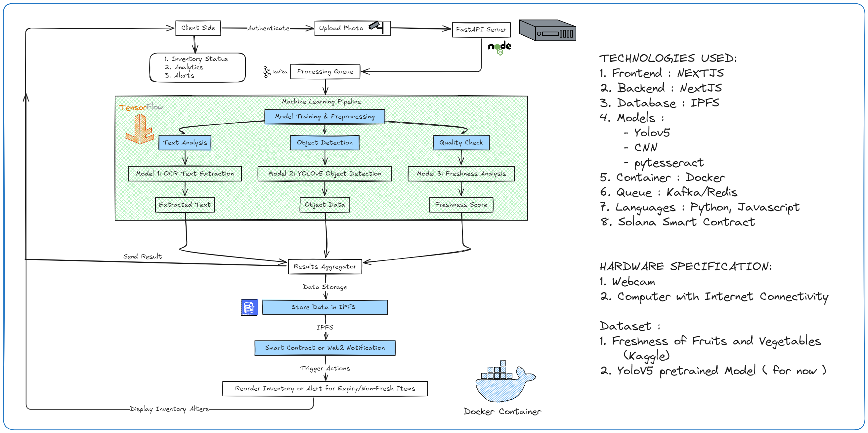
Technical Approach:
Teams to submit a solution proposal ppt that includes details on the technology used, hardware specifications, items used to train the model, and code, accompanied by a video simulation

